Slide 1

Rating Prediction Project
Submitted by:
Shama Tanweer

Slide 2
Introduction
In an ecommerce-driven world where customers can’t physically experience products before purchasing, many consumers turn to online product reviews
Websites and online stores increasingly rely on rating systems and interactive elements for visitors and customers: users leave ratings on websites or give their opinions on products and companies using the comment boxes embedded on the page.
Customers and website visitors often gain important information through ratings and can read other user’s experiences before investing in a product, service, or company.
For any company that exists in the digital space, online reviews are critically important when it comes to winning business and maintaining a positive reputation

Slide 3
Problem statement
This project is related a website where people write different reviews for technical products. Now a new feature has been added to website i.e., the reviewer will have to add stars (rating) as well with the review. The rating is out 5 stars and it only has 5 options available 1 star, 2 stars, 3 stars, 4 stars, 5 stars. Now the requirement is to predict ratings for the reviews which were written in the past for which website don’t have a rating. So, we have to build an application which can predict the rating by seeing the review.

Slide 4
Exploratory Data Analysis
Checking shape of data.
Checking data types of each features using dataframe.info() function.
checking for null values in each column,and treating them.
Pointing out irrelevant features in dataset like ,unnamed:0’ & ‘unnamed:01’.
Addition of new features to check the length of headline and news before and after preprocessing.
Cleaning the raw data-It involves deletion of words or special characters that do not add meaning to the text.
Important cleaning steps are:
Lowering case
Handling of special characters
Removal of stopwords
Handling of hyperlinks
Removing leading and trailing white space
Replacing urls with web address
Converted words to most suitable base form by using lemmatization

Slide 5
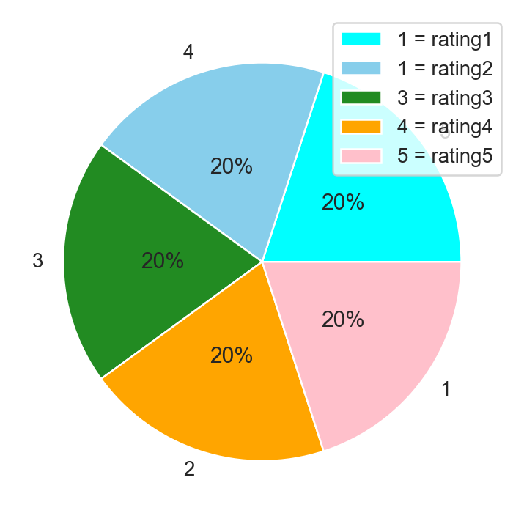
Checking distribution of rating
Previously the data was imbalanced with highest number of ‘5’ rating.We made it equally ditributed by making all rating equally distributed

Slide 6
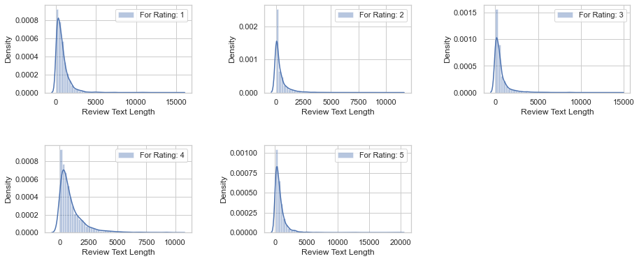
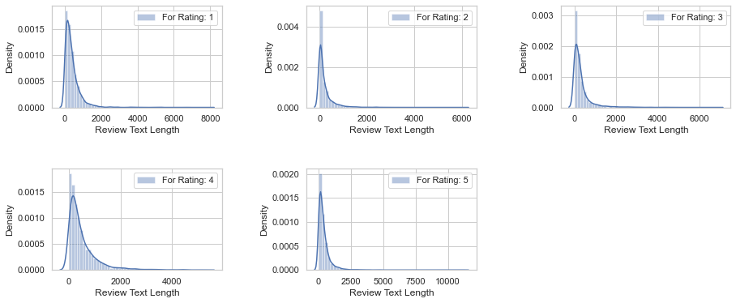
graph to show distribution of reviewslength before cleaning and after cleaning
Before cleaning:
After cleaning:

Slide 7
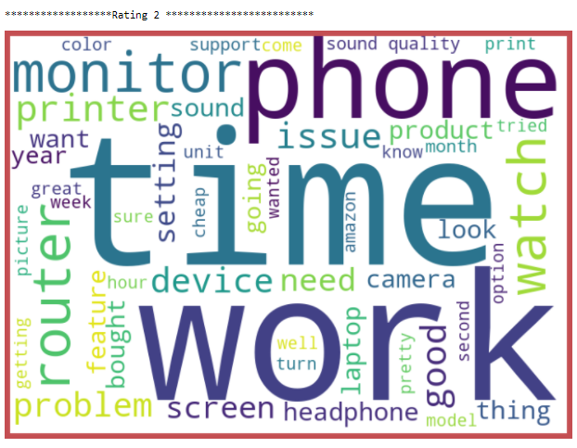
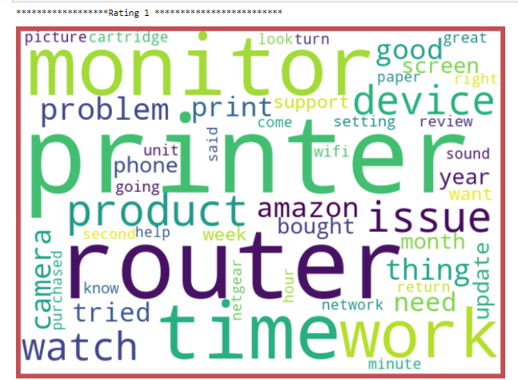
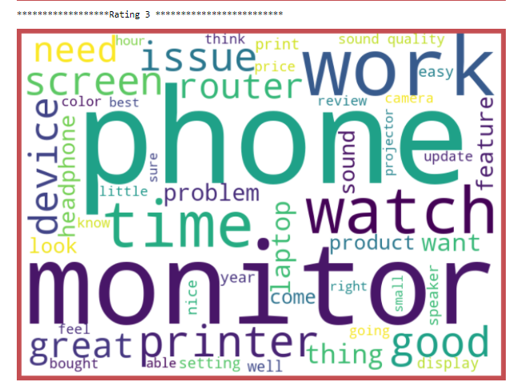
To get better view of words contained in Review. A word dictionary (wordcloud ) was made showing the first 50 words highly occurred in reviews according to rating
plt.show()

Slide 8
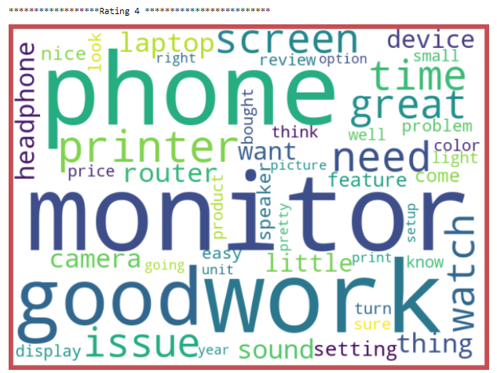
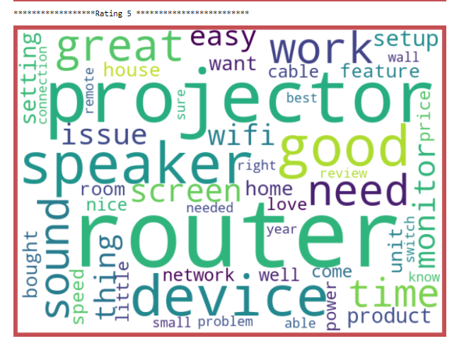

Slide 9
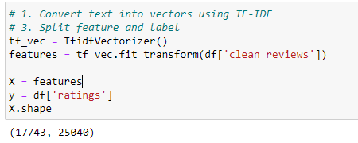
Training Classifier: We converted all the comment text into vectors , using TF-IDF. Then we have split features and label.

Slide 10
Model Building & Performance
it’s a classification type problem and below models were used:
DecisionTreeClassifier
RandomForestClassifier
AdaBoostClassifier
MultinomialNB
XGBoost Classifier

Slide 11
Evaluation Matrices:
Accuracy - it determines how often a model predicts default and non default correctly. Confusion matrices :It gives direct comparisons of values like True Positives, False Positives, True Negatives and False Negatives
classification report :It displays the precision, recall, F1, and support scores for the model

Slide 12
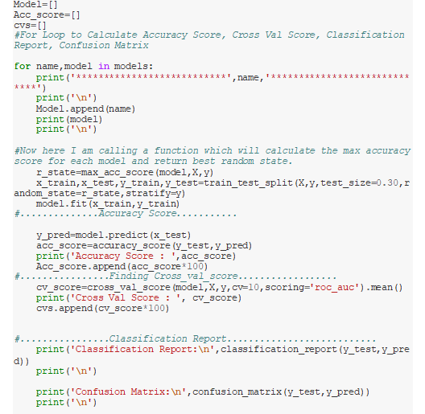
All algorithm by using for loop

Slide 13
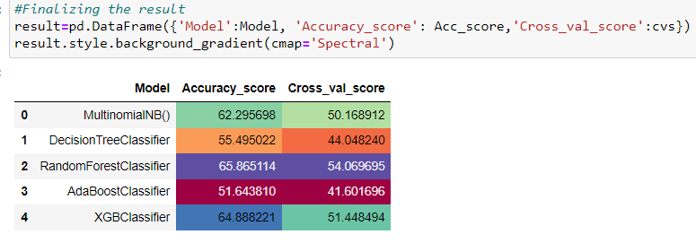
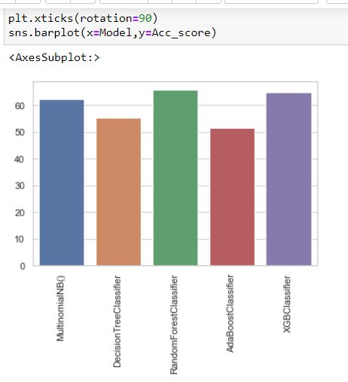

Slide 14
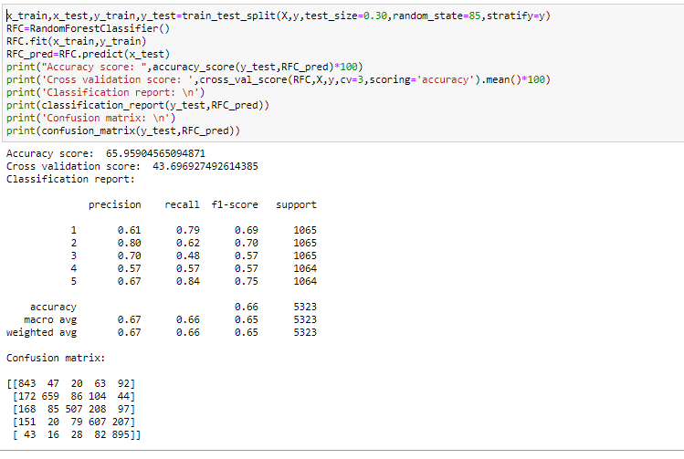
Final Model
We choose RandomForest Classifier model as the final one,as it gives hightest accuracy score

Slide 15
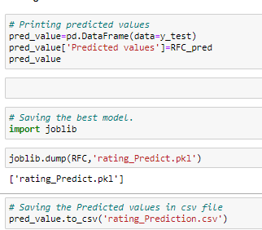
Saving the best model

Slide 16
Conclusion
Key Findings and Conclusions of the Study
Dataset was quite imbalanced with very high number 5 ratings in comparison to other ratings. Raw data contained many unwanted text. .After all the process used in Natural Language Processing has been applied on our dataset, our model is able to predict ratings with an accuracy of 65% with Random forest classifier.
Learning Outcomes of the Study in respect of Data Science
I found visualisation a very useful technique to infer insights from dataset especially in case of large datasets.
Use of TF-IDF was very helpful in text to numeric conversion

Slide 17
Limitations of this work and Scope for Future Work
Although I have performed all necessary steps of data cleaning I was able to get 65% of accuracy . With web scraping, more data can be retrieved and can be used to train the model. More data will build the model better.. Currently, despite having retrieved more than 20K data from the e-commerce websites, balancing the data with the same count of ratings was a major objective but had to leave out many reviews. So more data will definitely help in achieving high accuracy
Current model is limited to technical product rating(s) and reviews data but this can further be improved for other sectors of ecommerce rating(s) prediction by training the model accordingly. The overall score can also be improved further by training the model with more specific data.

Slide 18
Thank YOU

